Slide 1
EXPIRY.ALERT
FOOD + MEDICINE
Smart Household Expiry
Management System
ADD PRODUCTS
TRACK EXPIRY
GET REMINDERS
A simple system that helps households prevent unsafe use and reduce avoidable product waste.
SYSTEM DESIGN PRESENTATION

Slide 2
EXPIRY.ALERT
02
Why the existing approach falls short
Manual checking is inconsistent, fragmented, and easy to forget.
Memory-dependent
No early warning
People must remember dates for every item.
There are no reminders before an item expires.
Scattered information
Health and waste risk
Food and medicine details are not stored in one place.
Expired items may be used or usable items discarded late.

Slide 3
EXPIRY.ALERT
03
Scope of the proposed system
EXPIRY.ALERT centralizes product records and acts before expiry dates arrive.
Add products
Food or medicine
Store details
Dates, quantity, category
Check expiry
Compare against current date
Send alerts
Upcoming or expired items
The EXPIRY.ALERT system is here to help people keep track of when their food and medicine expire. With EXPIRY.ALERT users can add details about their products look at the expiry dates and get warnings before they expire. EXPIRY.ALERT helps reduce waste makes things safer and makes it easy to keep track of everything. EXPIRY.ALERT can be really useful for people at home for stores and for small businesses.In the future, more features like barcode scanning, QR code scanning, and image-based expiry date detection can be added. The system can also generate monthly reports of expired and upcoming expiry items. It can be used on both mobile phones and computers, making it more convenient for users to manage their products anytime and anywhere.

Slide 4
EXPIRY.ALERT
04
Requirements define a secure, useful, and dependable system
Functional requirements
Non-functional requirements
• Register and log in
• Add, edit, and delete products
• Store expiry dates
• Send reminders
• Show upcoming and expired items
• Easy to use
• Fast performance
• Secure user data
• Works across devices and browsers
• Reliable and maintainable

Slide 5
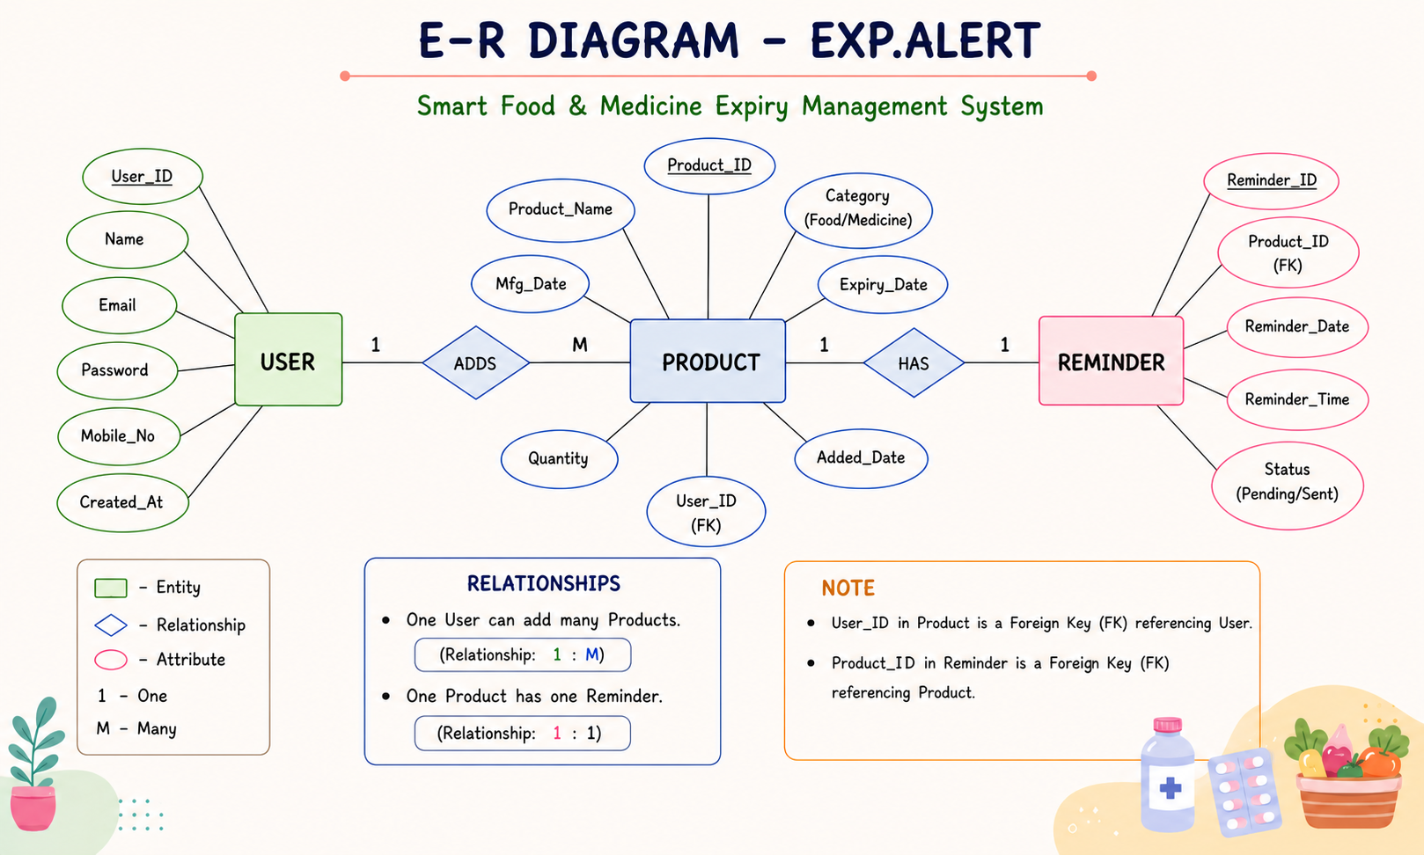
EXPIRY.ALERT
05
ER diagram: users own products; products create reminders
Core database relationships for expiry tracking.

Slide 6
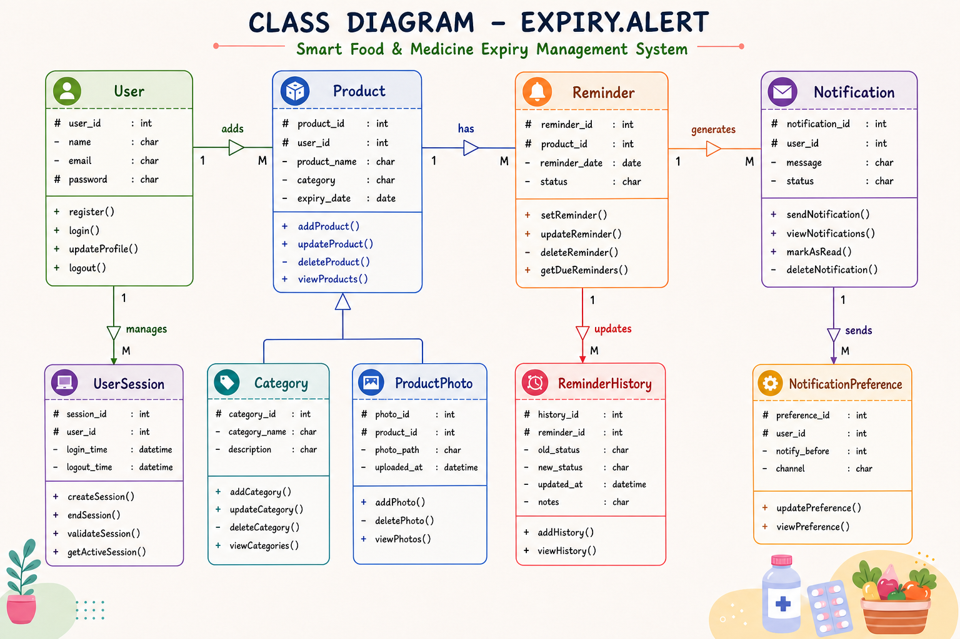
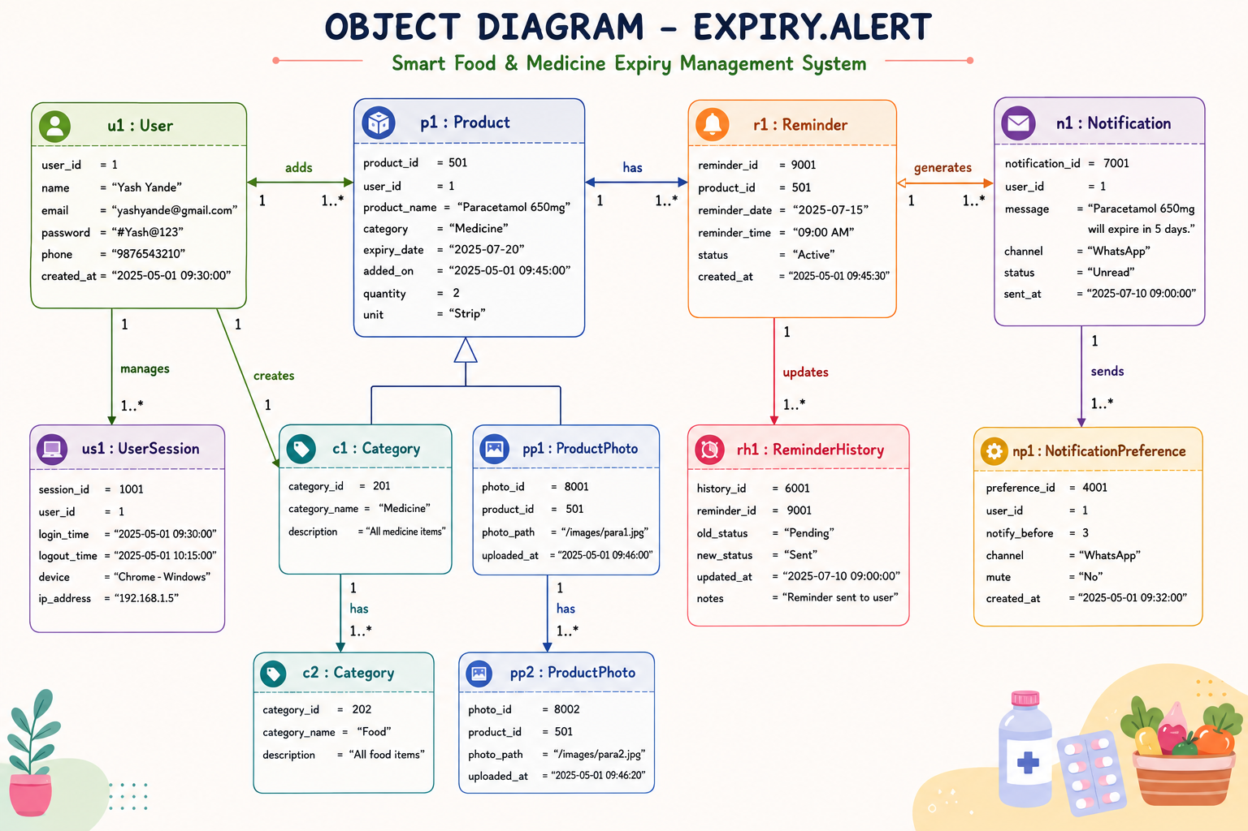
EXPIRY.ALERT
06
Class and object diagram: the system manages three core objects
Each class maps directly to a database entity and its behavior.

Slide 7
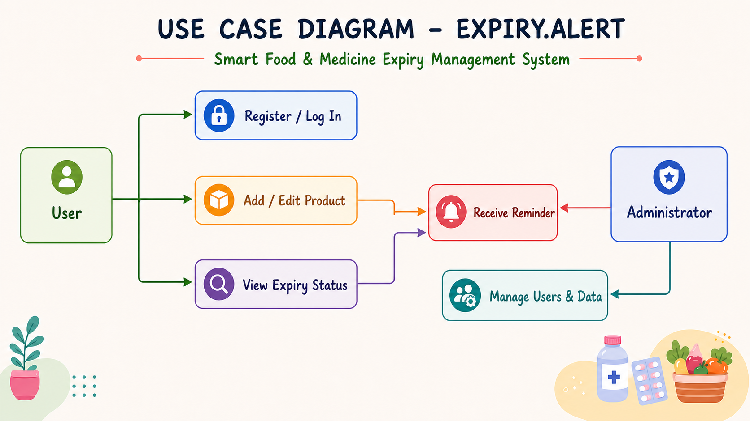
EXPIRY.ALERT
07
Use-case diagram: users manage products and receive alerts
The administrator maintains the user and system data.

Slide 8
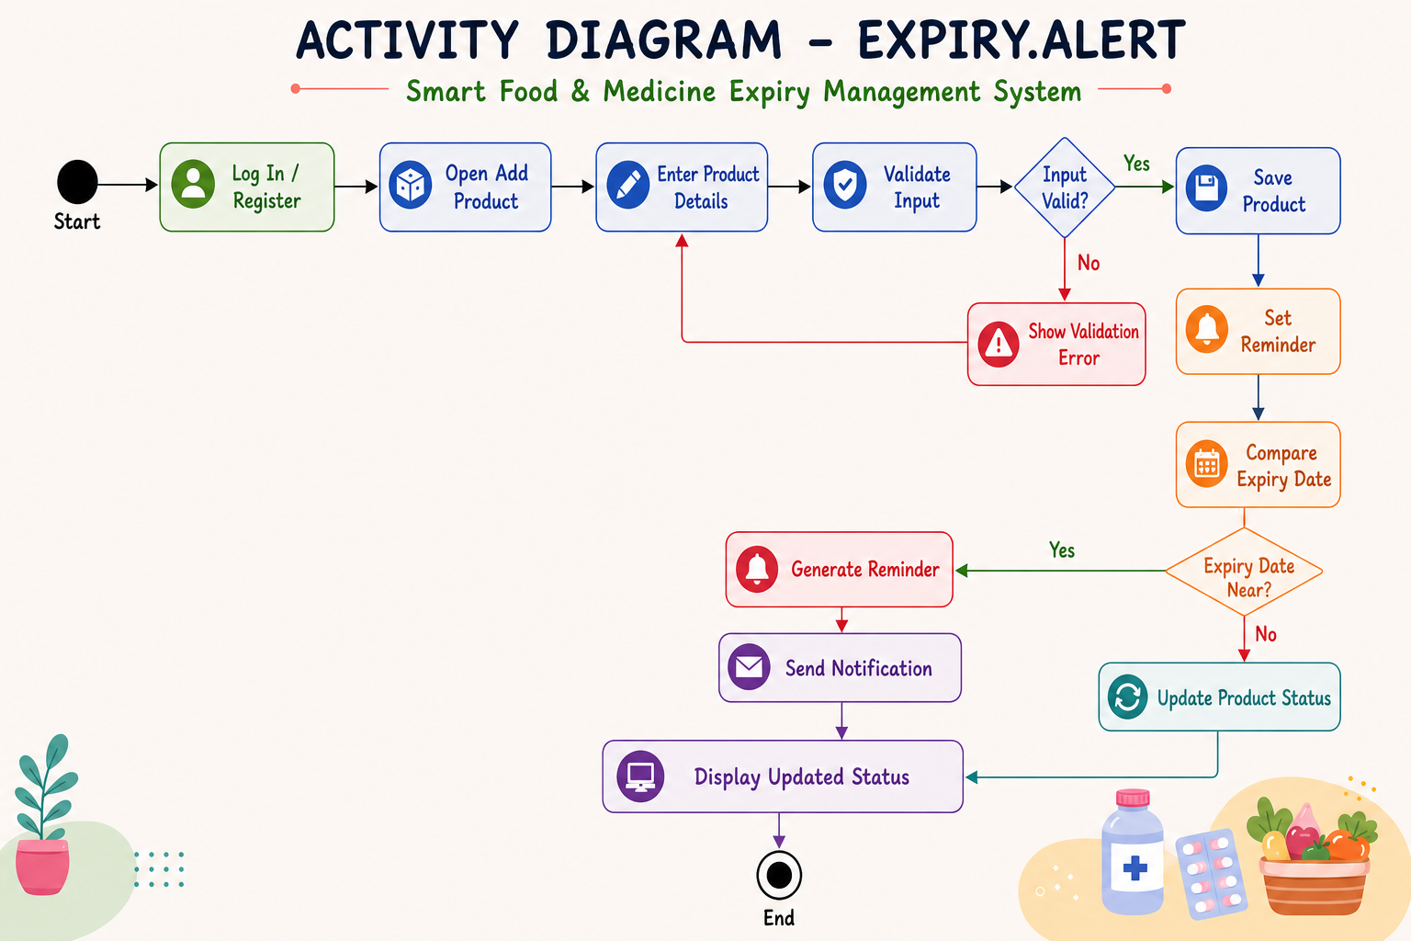
EXPIRY.ALERT
08
Activity diagram: capture, validate, monitor, and notify
A repeatable workflow turns product data into timely action.

Slide 9
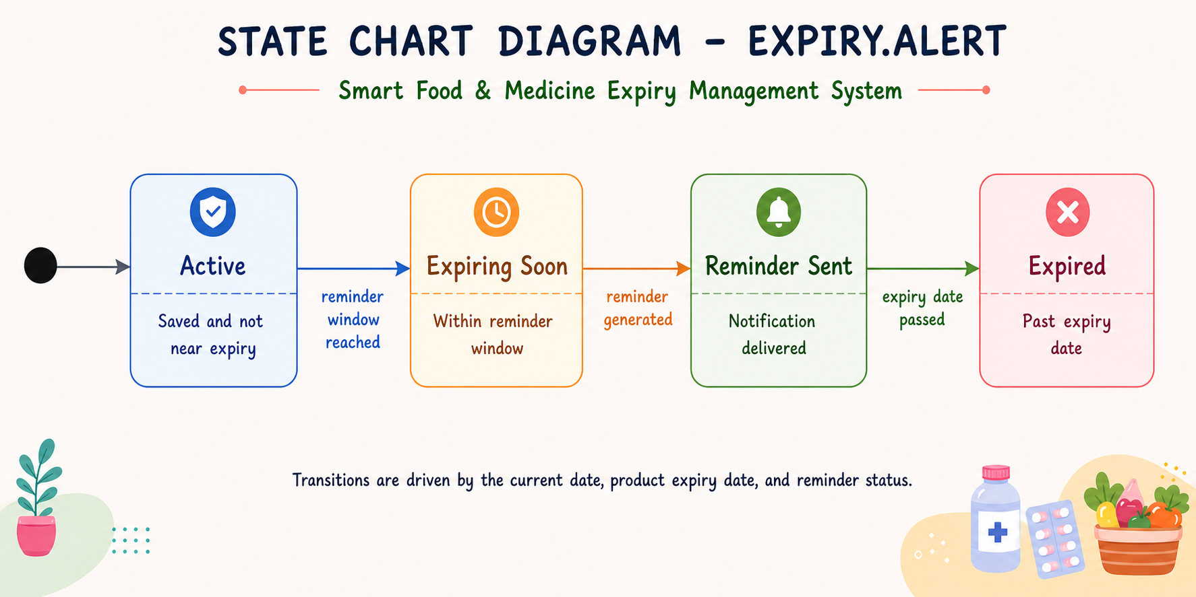
EXPIRY.ALERT
09
State chart: every product has an actionable expiry status
Date comparison moves a product through clear, user-visible states.

Slide 10
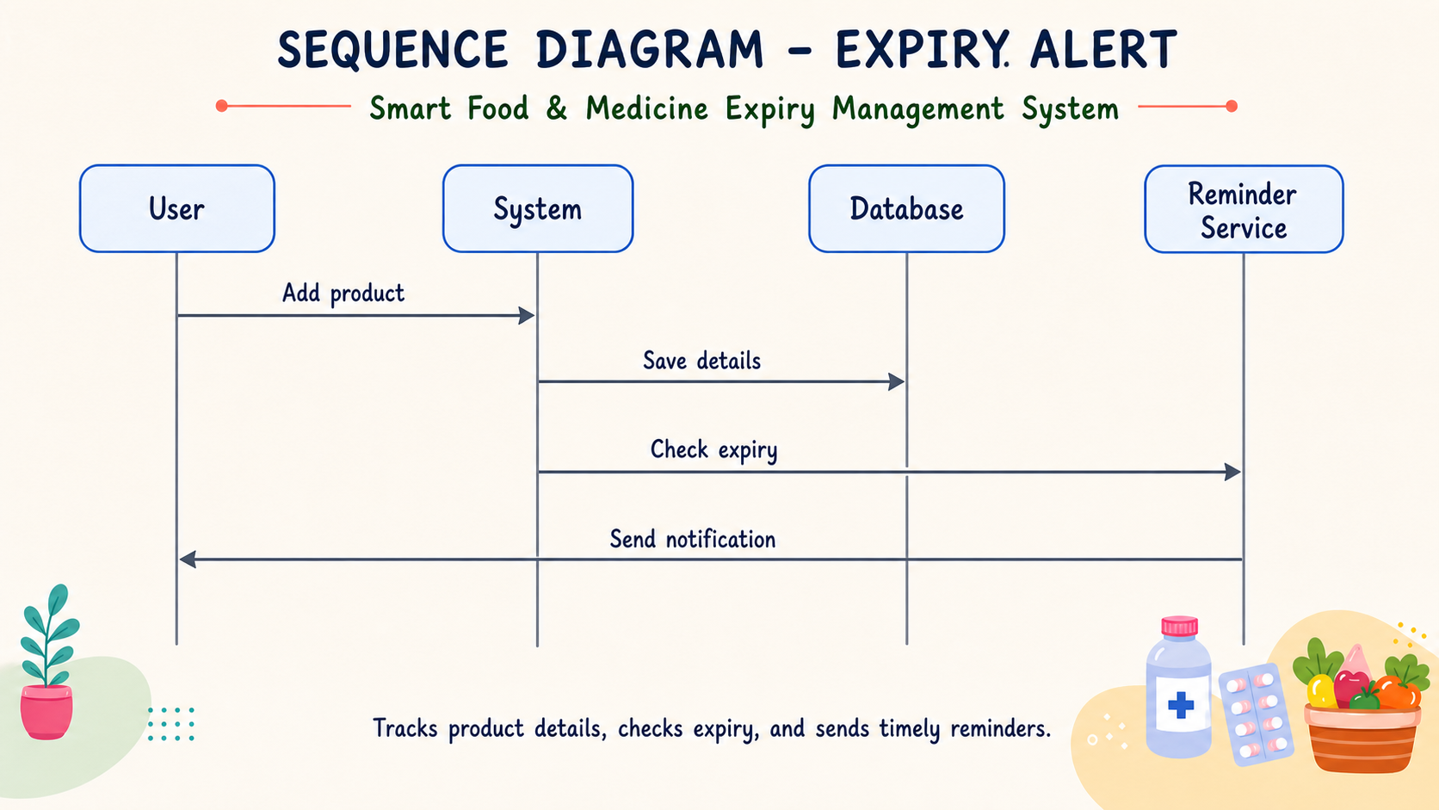
EXPIRY.ALERT
10
Sequence diagram: how the system triggers a reminder
The reminder service connects saved product data to the user notification.

